Slide 1
Section 6.2
Volumes by Slicing: Disks and Washers

Slide 2
All graphics are attributed to:
Calculus,10/E by Howard Anton, Irl Bivens, and Stephen Davis Copyright © 2009 by John Wiley & Sons, Inc. All rights reserved.

Slide 3
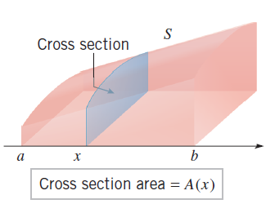
General Idea/Definition of Volume
In order to find volume we are first going to slice a three dimensional space (such as the one seen at the right) into infinitesimally narrow slices of area.
Then, find the area of each slice separately.
Next, find the sum of all of the areas (which will bring in the Sigma notation).
Calculate the limit as the number of slices approaches infinity to get an accurate measure of volume.

Slide 4
Which Area Formula?
The formula depends upon the shape of the cross-section. It could use a circle, square, triangle, etc.

Slide 6
Rotating Area using Discs to Find Volume
One of the simplest examples of a solid with congruent cross sections is
We are going to use all of the same ideas from Section 6.1 and more, so I am going to remind you of the process.
The difference is that after we find the area of each strip, we are going to rotate it around the x-axis, y-axis, or another line in order to find the resulting volume.

Slide 7
These notes are incomplete, so make sure you leave room to add things next class.
If you prefer, you may take notes from the book.

Slide 8
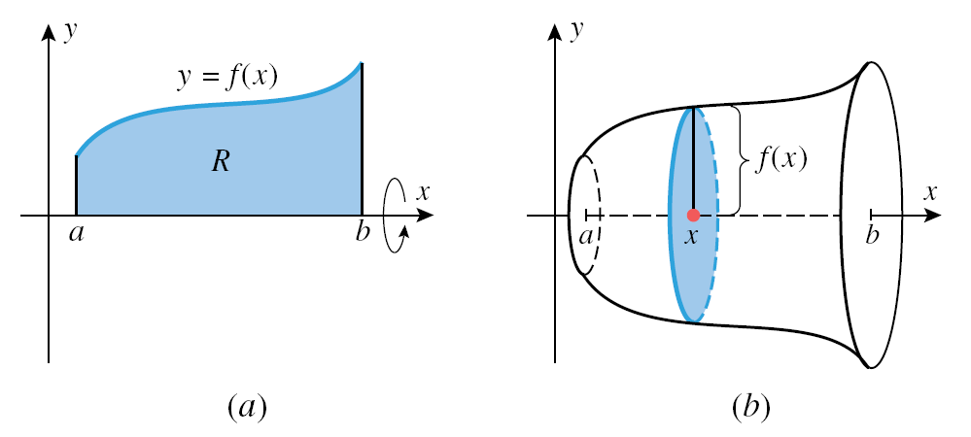
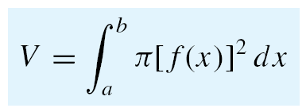

Slide 9
Proceed to next slide

Slide 10
Rotating Area using Washers to Find Volume
We are going to use all of the same ideas from Section 6.1 and more, so I am going to remind you of the process.
The difference is that after we find the area of each strip, we are going to rotate it around the x-axis, y-axis, or another line in order to find the resulting volume.

Slide 11
Remember: Area Between y = f(x) and y = g(x)
To find the area between two curves, we will divide the interval [a,b] into n subintervals (like we did in section 5.4) which subdivides the area region into n strips (see diagram below).

Slide 12
Area Between y = f(x) and y = g(x) continued
To find the height of each rectangle, subtract the function output values f(x_{k}*) – g(x_{k}*). The base is .
Therefore, the area of each strip is base * height = * [f(x_{k}*) – g(x_{k}*)].
We do not want the area of one strip, we want the sum of the areas of all of the strips. That is why we need the sigma.
Also, we want the limit as the number of rectangles “n” increases to approach infinity, in order to get an accurate area.

Slide 13
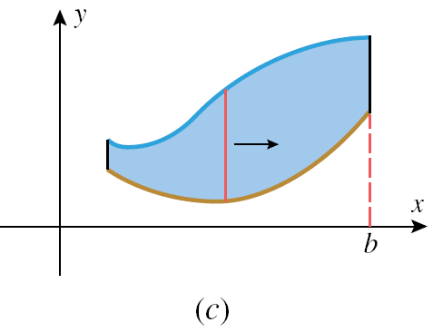
Picture of Steps Two and Three From Previous Slide:

Slide 14
Volume
To find the height of each rectangular strip, subtract the function output values f(x_{k}*) – g(x_{k}*). The base is .
Therefore, the area of each strip is base * height = * [f(x_{k}*) – g(x_{k}*)].
We do not want the area of one strip, we want the sum of the areas of all of the strips. That is why we need the sigma.
Also, we want the limit as the number of rectangles “n” increases to approach infinity, in order to get an accurate area.

Slide 16
Y - Orientation

Slide 18
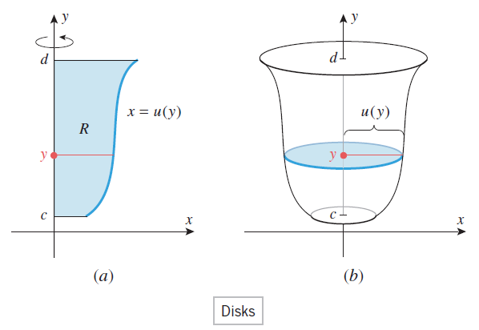

Slide 19
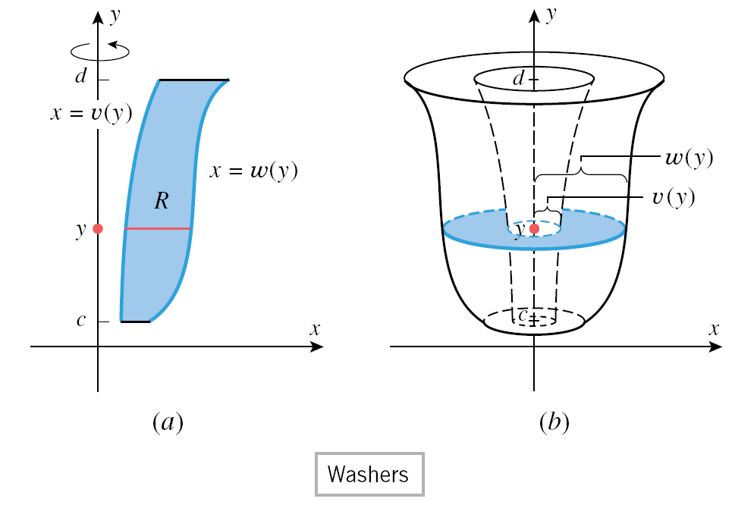

Slide 20
That is all for now.

